Slide 1
Discovering Group Coordinators
Having effective GC inviting conversations
Notes:
PRAY!!!

Slide 2
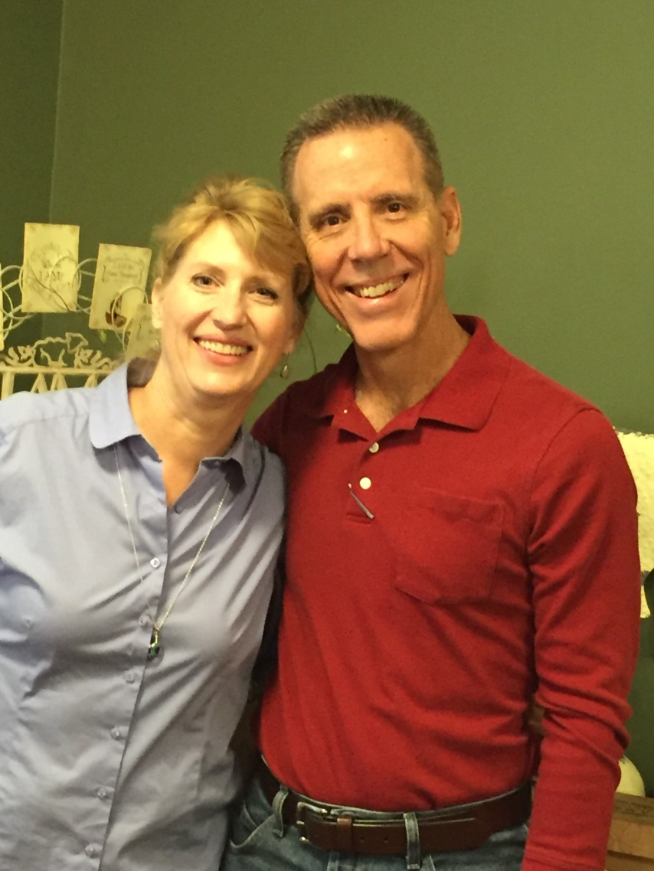
Introduction
Notes:
(1 minute)
2-3 minutes or so intro. 30 second testimony/story is part of the time
Included Family photo if desired
Life prior to FL, Years at FL, Current role, Passion for role
ICEBREAKER activity may be appropriate at this point

Slide 3
Overview of our Time
Conversations
The Tools
Notes:
2 min
Two goals of this session
Polish our skills on how to connect and have conversations
Refresh on how to use the tools (Calling guidelines & GC Mobile)

Slide 4
Understand Why We Invite
Become Equipped
Build Confidence
Know Expectations
Goals for this Session
Notes:
2 mins
Goals for having a Conversation
Why we invite (Casting Vision)

Slide 5
The bedrock of the local WTR volunteer team
To Discover Group Coordinators!
To Coach Group Coordinators!
Notes:
(5 minutes)
In this session I want us to concentrate on Discovering Group Coordinators!
We are a grassroots ministry. Without our soldiers on the ground we can’t win the war.
You may be thinking “We’re just making phone calls.” Let me tell you a short story!
One is hauling bricks
The other one is building a cathedral - WHAT IS THE DIFFERENCE BTW the TWO? VISION!!!
What you do has a tremendous eternal impact. I know that you know this or you would not be here.

Slide 6
:30 Story
So what’s your story?
How did God intervene in your life/marriage through the Weekend to Remember?
Be passionate and personal!
Activity:
1. Review your story for 2 minutes
2. Share your story with a partner
-Time one another (30 seconds or less)
-Look for clarity and conciseness
-Switch
One
home
at a time
Notes:
(2 mins to model and explain & 8 minutes for writing out and sharing with partner)
PRE-ASSIGNMENT: You should have begun your 30 second story prior to tonight. Use what you have
Why a 30 second story? Connecting, building common ground/relationship
Model 30 sec story. Highlight points to include in story. PAGE 5 IN THE NOTES.
Give group time to share 30 second story with one another. Have them time each other.
Score on meeting time limit, clear concise story.
Ask them to practice up to 3 times. If they need more practice may need to take off line to work with WTRD.
Have one or two people share with the group.
Stop sharing and open for comments/questions!
WHAT IS A GROUP COORDINATOR? With a group name you can save a couple $100 on the reg. rate. For every 5 couples that register using your group name, you can earn a free couples registration to use or to pass on to someone else.

Slide 7
Help and Hope!
Group Rate - $100 savings per couple
Free couple registration earned with every 5 paid couple registrations
Half Price offer! (Dates)
Group Plan Highlights
Notes:
2-3 Mins
Use this complimentary registration yourselves or transfer it to another couple.
You can offer to the potential GC the savings and they earn a complimentary registration to use or give away.
HALF PRICE OFFER! Write down these dates – Jan. 3-24

Slide 8
Words Matter
“Recruiting” is all about talking people into joining US in accomplishing OUR goals and plans
“Discovering” helping others to realize and follow THEIR God-given calling, and fulfilling His plan for THEM.
WORDS TO USE | WORDS TO AVOID
Volunteer | Advertise
Invite | Promote
Minister | Recruit
Help Your Friends | FamilyLife
Weekend to Remember | (i.e. by itself; always use with Weekend to Remember)
One
home
at a time
Notes:
5 mins
You will notice I use discover GC or invite GC to participate. I don’t use the word recruit. Here is why.
We can tend to fall into using secular marketplace terminology, like recruit, advertise, promote.
Use ministry minded words instead of marketplace words.
We want to be intentional about how we communicate. Words matter (ANY THOUGHTS?)

Slide 9
Why We Invite!
Last WTR Impact
Attendance: 658
GC’s: 80
Group Registrations: 290
Salvations: 21
Testimony
“We are more committed to our marriage. Before coming we were talking seriously about divorce. We had a deadline on if we could/couldn’t make it work. Now that’s no longer on the table. We’re in this for the long haul!”
Married 10 years
One
home
at a time
Notes:
(5 mins)
60-70% of couples who attend a Weekend to Remember do so because someone cared enough to invite them?
Last year your work resulted in……….
Your work matters!
Your work or labor is not in vain 1 Cor 15:58
EXPLAIN PRE-DISCOVERY EMAILS AND IMPACT! Talk about calling each one that responded to either say This is _______ and I’m so glad you reactivated your group name in August. I look forward to touching base with you periodically as we lead up to the WTR to pray for you, get you materials, answer questions, etc. My number is _____. OR This is ________ and I’m so glad you reactivated your group name for the Weekend to Remember in Orlando. I am your local volunteer contact here in the Orlando area. If you have any questions, need materials, or would like any help at all, please don’t hesitate to call me at ________.

Slide 10
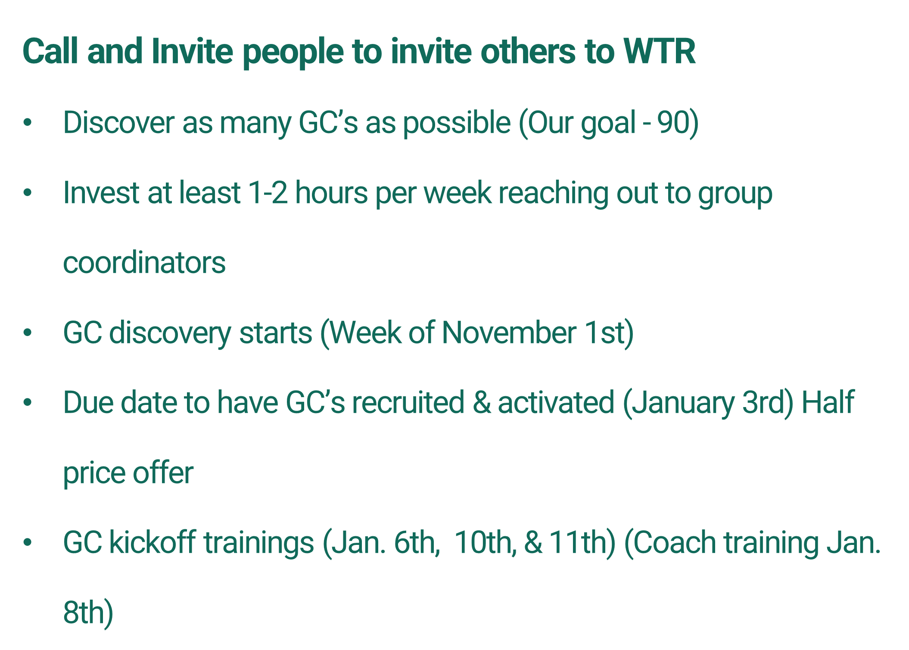
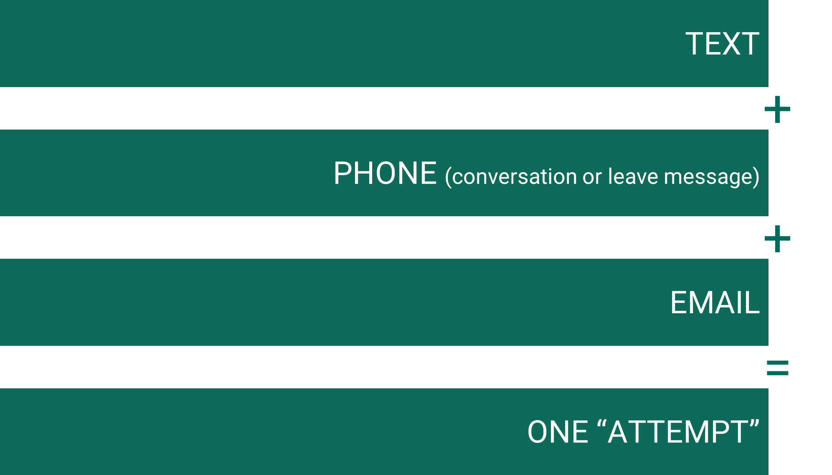
Notes:
10 mins
Why Call
2nd best way to build relationship (1st is face to face)
personal touch.
Easier to gauge interest, sincerity
Uplifting and encouraging
Stop sharing and open for questions!

Slide 11
What we are not asking you to do
Telemarketing (this is about building relationships)
Guilt or Manipulate people into volunteering
Notes:
1-2 mins
Telemarketing feels painful and extremely negative. We will address how to help people realize you are not a telemarketer
Guilt or manipulation results in people saying yes but who probably do very little or nothing at all

Slide 12
Elements of GC Conversation
Introduction & Ask Permission
Hear Their Story
Share Your 30 second story as led
Connect to the Need Around Them
ASK
One
home
at a time
Notes:
3 mins
You can gloss over these by briefly introducing and on the next slide go into more detail using the script enclosed in their packet.
Or you can walk them through the script here and model each element.
The danger in doing to much is you spend a lot of time explaining and not as much on practicing. Use your discernment in judging the best approach.
Below are notes Keith Tully uses for this slide:
Our heart now is to prepare you to make calls to someone who has been to a Weekend to Remember. For many of us this is scary. I have been making calls for 25 years and I still pray before each call asking God for courage. By the time we are done today, I believe you will be confident that you can approach someone who has attended a WTR OR someone in your personal network with confidence.
Your first step is your introduction. You will always want to introduce yourself as a volunteer. When couples receive your call, what are they going to think that you are? (a telemarketer) Introducing yourself as “a volunteer for the Orlando FL Weekend to Remember team” will start to bring their walls down.
And we always begin by asking if they have a few minutes to talk. You may say, “the Weekend to Remember is coming back to Orlando this next spring. At the getaway last year, you indicated a desire to invite other couples. Do you have a few minutes to talk now?” We ask permission to honor the ones we are calling. The word of God encourages us to “honor one another above yourselves.” When we honor them, we reflect Christ. If they don’t have time right then, ask them for a better time to call back. If they give you a time, make sure it works for you too and be diligent to call back right at that time. If we call back right when we tell them we will, what does that communicate? (respect, integrity, and urgency).
Some of your calls will simply be divine appointments. The couple may be separated. They may be divorced. The person may have just found out they have cancer or just been fired. Simply stop, listen, encourage, and ask them if you can pray for them. After praying, get permission to share the prayer request with our intercessory team and ask them if you can call back to follow up. When Jesus gave us that encouragement to “pray for the harvesters”, he was in the middle of the crowds teaching, healing, and comforting. May we be like Jesus – working strategically for the harvesters and yet not missing a single person God puts in front of us.
After we have permission to talk, we begin by asking how the Weekend to Remember went for them. If they simply say fine, then share our story of how the WTR impacted you. This is quick – 30 seconds or less – and ends in an open ended question – How did the WTR impact you and your marriage. The hope is to change this from a call from someone they do not know to a personal call very quickly. God lives in your testimony. As they hear your testimony and remember what God did for them, the Holy Spirit has the opportunity to stir their hearts. As they share, you “listen actively”. After they have shared, we take what God did for them and connect it to the great need all around them. If God taught them how to listen to their wives for the first time, we want them to understand that there are hundreds of men around them who need to learn that too. This leads us to the ASK. Five steps of the outline to the ask. We are going to go into them in more detail and practice them together. But before we move on, let’s say these five together “1 – Introduce & Ask permission 2 – Share your story 3 – Hear their story 4 – Connect their story to the need around them 5) Ask

Slide 13
Scripts
Use script: “Sample Script for New Group Coordinator”
Modify it to make it your own
- However don’t change key ideas
3. Find a partner and role play.
- Take turns receiving the call
- This may feel mechanical or awkward. That is okay!
4. When both partners have shared, make adjustments and share again.
- Practice at least 2 times or as time allows
One
home
at a time
Notes:
Time needed: 25 minutes
May need to model it before setting them loose. (Depends on if you went over the script on previous slide. ) (Remember if both of you are going to make contacts, then both go through the practice calls as the coach. If only one of you is going to be doing the contacting, then you go over the call 3-4 times.)
Walk through the script in the packet. Go through each of the five areas either one at a time explaining the thinking in each one. (This may be new material or just a review depending on the volunteer group.) Be careful not to be long winded. Be concise, answer questions and move on. Make sure the majority of your time is spent on the activity not on your explanation. Their practice time is more beneficial than your sharing your knowledge. This is about them learning and growing.
Then give the group some time to read through their scripts individually and then split in to groups of 2 to practice.
Rep should then walk around listening and coaching. Pick two people to model in front of group after practice time.
Have group critique overall role play of two people. (WHEN BACK TOGETHER, ASK HOW IT WENT, AND WHAT QUESTIONS CAME UP)

Slide 14
Break (Grab a snack & be back in 15 minutes!)

Slide 15
Leaving an Effective Message
Review “Leaving Message Script”
Rehearse with a partner
Receive partner feedback
Notes:
10 mins & 2 min. for sharing
Remember a voicemail is a great way to connect. (However most people will not call you back no matter their passion)
Leaving a message is vital and important. Great way to connect. Be clear and concise. Leave name why you are calling, that you will call back, and end with name and number to call back.
Be encouraging but short. Ask: do you listen to 2 min messages on your voicemail? Rarely.
STOP SHARING AND OPEN FOR COMMENTS/QUESTIONS

Slide 16
Email & Text
Some people will not answer the phone
Complete the ATTEMPT!
Notes:
3 mins. Depends on group and their comfort with text and email
Use Text to set up time to call/connect. Check on interest. Key point is to look at demographic of persons. Older generation may respond to text by wanting to set up call. Younger people prefer engaging only through text. However, a phone call is still better to have at some point. See text templates in packet
Email-great way to connect with people to see if they will engage. Use email to engage by sending one after leaving a message. Short and concise like leaving a message is best. See email templates in packet

Slide 17
Email
Best Practice:
Email after attempting to contact as a follow-up
Include why you called. You can go into more detail in an email than you have room for in a VM. Mention you will contact again, but they can call you.
Be encouraging
Subject line should effectively summarize the email
- ex. FamilyLife Weekend to Remember Invitation Plan
Caution: Email is not a replacement for a phone call
One
home
at a time
Notes:
3 mins
Email-great way to connect with people to see if they will engage. Use email to engage by sending one after leaving a message. See email templates in packet

Slide 18
Text
Best Practice:
Check to see if it is a good time to call
Set a time to contact
Send web links or web site gcmobile.familylife.com
Caution: Texting is not a replacement for a conversation
One
home
at a time
Notes:
3 mins
Self explanatory slide

Slide 19
Discovering GC Call Challenges
Reasons people may be hesitant to say yes
Call challenges - page 16
Notes:
8 mins
Activity: Have the group identify as many objections or challenges they can think of. You may need to start with an obvious one to get them thinking.
If the group is new and may struggle coming up with some you may have to have a list prepared in advance to review
Divide challenges up among group and have them come up with ideas to potentially overcome
If the person says no then they are done. However, people may just need a bit of encouragement to say yes without manipulating or guilt.
Share ideas with group. May use common objection document on Volunteer website.
Common Objections document (http://volunteer.familylife.com/overcomingobjections/)
Ask questions on next page!!!! DON’T switch slides yet!

Slide 20
Elements Included in a Call (Review)
Introduction & Ask Permission
Hear Their Story
Share Your Story as led
Connect to the Need Around Them
ASK
Notes:
3 Mins
Discussion format. Ask them questions as part of reviewing. Get them engaged. You may be losing them at this point in training.
Why review this. Very important part of training. Probably most important.
Ask questions of each.
What does number 1 sound like? Open the door for conversation
Why is hearing their story important? People love to talk about themselves. Builds connection/relationship. Opens door to help them see need around them.
Why a 30 second story? Connecting
How do you connect their story to the need around them.
Why ask? Finality. Nothing happens if you don’t ask. Great call but no fruit. They asked us to call them.

Slide 21
Other Elements
If “yes”, ask for best contact info (phone#, email, text)
Smile!
Sign up on GC Mobile (if appropriate)
Discuss next steps (kickoff gatherings, future contacts, email, etc.)
Thank them for time
- Be Encouraging!
- If led, pray for them
If not interested thank them for time
One
home
at a time
Notes:
3 mins
This is less discussion and more lecture
When it comes to making these contacts:
Let me encourage you to be intentional and set an evening of the week that you will make contacts. If you don’t, chances are you never will. If you are thinking “I’ll make those calls tomorrow, this is what tomorrow means.”

Slide 22
“Whatever you do, work heartily, as for the Lord and not for men”
Colossians 3:23 (ESV)
Procrastination
Tomorrow – a mystical land where 99% of all human productivity, motivation, and achievement is stored
Plan & Prioritize
Notes:
2 mins
Plan and Prioritize:
Get out your calendar. What is the best night to call for your schedule? Take a minute and look at your schedule and think thru your schedule and pick a night.
Share time expectations per week

Slide 23
[Israel's Only Savior] But now thus says the Lord,
he who created you, O Jacob, he who formed you, O Israel:
“Fear not, for I have redeemed you;
I have called you by name, you are mine.”
Isaiah 43:1
Notes:
1 mins
Use these verses or ones you prefer. Let the Spirit lead

Slide 24
GC Mobile
What is GC Mobile?
A simple online tool for GC’s to get a group name
Attributes:
Simple to use
Mobile friendly
Easy to update
One
home
at a time
Notes:
5 min.

Slide 25
Pray!
Review script for call
Review script for leaving message
Before dialing review person’s information
Before the Call Tips
Notes:
3 min.
As I have gotten older I think I have simply realized how incapable I really am without God, so I pray before every call I make, whether it is raising support, calling potential GC’s, coaching GC,’s, etc.
Lay out & review personal info on calling sheet – layout & review calling guide – lay out & review leaving message

Slide 26
Smile (enjoy the call)
Be Conversational
Follow Script (as needed)
During the Call Tips (if they answer)
Notes:
1 min.

Slide 27
After the Call Tips
Email after calling (if left message)
If yes, & they don’t go on GCmobile with you while on the phone, email GCmobile instructions
Enter information in Database
Go to next number
One
home
at a time
Notes:
2 min.

Slide 28
Expectations of when you call
Remember people are not eagerly waiting for your phone call (intro yourself as local WTR)
Rarely will you have someone hang-up
20% of people will answer 80% won’t
You will get to leave lots of messages
One
home
at a time
Notes:
3 min.
Since 80% won’t answer the phone – 2 KEY OPPORTUNITIES - 1) LEAVE A GREAT VOICE MAIL MESSAGE
2)AFTER EMAIL, IF NO RESPONSE IN THE NEXT 24 HOURS, THEN TEXT. THAT MAKES ONE ATTEMPT.
MANY PEOPLE THAT DID NOT RESPOND TO EITHER PHONE CALL OR EMAIL, RESPONDED ALMOST IMMEDIATELY TO TEXT
5 MIN BREAK AND OPEN THEIR PERSONAL LINK ON OTHER LAPTOP

Slide 29
Q & A

Slide 30
Our PURPOSE
One
home
at a time
To help families grow together and impact their corner of the world

Slide 31
Our mISSION
To effectively develop godly families who change the world one home at a time
One
home
at a time

Slide 32
Every
home a godly home

