Slide 2
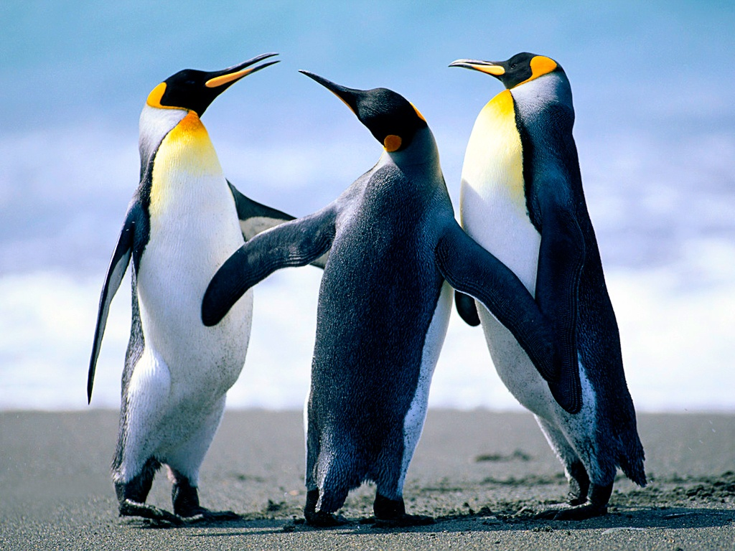
INTRODUCTION
Insert Family Photo Here
Notes:
2-3 minutes or so intro. 30 second testimony/story is part of the time
Included Family photo if desired
Life prior to FL, Years at FL, Current role, Passion for role
5 minute ICEBREAKER activity may be appropriate at this point

Slide 3
OVERVIEW OF OUR TIME
Conversations
The Tools
Notes:
1 min
Two goals of the day
Learn how to connect and have conversations
Learn how to use the tools (ZOHO, GC Mobile)

Slide 4
GOALS FOR 1st SESSION
Understand Why We Invite
Become Equipped
Build Confidence
Know Expectations
Notes:
1-2 mins
Goals for having a Conversation
Why we invite (Casting Vision)
Equipping to have conversations and how to leave msgs, txt etc.
Team Expectations for call numbers, GC inviting goals etc.

Slide 5
“WITHOUT VISION THE PEOPLE PERISH” Proverbs 29:18a
People have asked for help in bringing people
to the Weekend to Remember
Video
Notes:
3-4 minutes (includes video run time)
Option: Let volunteers know you will be asking them to identify the main points of the video.
Play video. If you prefer you can set up the video introducing Gene H. KEEP IT SHORT. Let the video do its magic.
At end of video move to next slide

Slide 6
SUMMARY OF VISION VIDEO
Together
Multiplies
Discipleship
Notes:
3-5 mins
Ask the team to summarize the main points of the video as a group. Then when they have shared theirs then share the three on the screen.
Each will fly in on a click
As a team we can encourage and help one another
You can influence/invite many more people than we at FL can thus multiplying all of our efforts
Discipling marriages and families that produce a Gospel legacy. Marriage is a back door in sharing the Gospel
ScriptureReference : John 4:36, Acts 2:44, Acts 4:31 Matt:28:18-20 Example passages use others as you see fit.

Slide 7
WHY ARE YOU HERE?
Discuss in small groups:
Why did God bring you here tonight?
Your Role: DISCOVER GROUP COORDINATORS!
Notes:
2-3 mins
Ask people to volunteer to share their thoughts. This is a get to know people time.
Possible Answers:
Jesus,
Attended WTR and Want to help others experience what we experienced
Help others
Evangelize
Have your answer fly in after team shares their thoughts.

Slide 8
30 SECOND STORY
So what’s your story?
How did God intervene in your life/marriage?
Be passionate and personal!
Activity: 1. Review your story for 2 minutes
2. Share your story with a partner
-Time one another (30 seconds or less)
-Look for clarity and conciseness
-Switch
Notes:
10-15 mins
PRE-ASSIGNMENT: You should have began your 30 second story prior to tonight. Use what you have
Why a 30 second story? Connecting, building common ground/relationship
Model 30 sec story. Highlight points to include in story.
Give group time to share 30 second story with one another. Have them time each other.
Score on meeting time limit, clear concise story.
Ask them to practice up to 3 times. If they need more practice may need to take off line to work with WTRD.
Have one or two people share with the group.

Slide 9
WHAT IS A GC?
GC = Group Coordinator
Invite people in their sphere of influence to Weekend to Remember
Work, Church, Family, Organization, etc.
Use Group Plan
Notes:
2 mins
The volunteers are finding people who are willing to invite using their sphere of influence.
They have already checked the box and want to help. They have asked for our help.
Don’t go into detail on Group Plan. (next slide) Incentive to encourage people to invite

Slide 10
GROUP PLAN HIGHLIGHTS
3 Major Benefits
Help and Hope!
Group Rate: $100 savings per couple
Free couple registration earned with every 5 paid couple registrations
Notes:
2-3 Mins
Use this complimentary registration yourselves or transfer it to another couple.
Focus on value not cost. Help marriages share biblical truths, etc. It does offer a monetary savings.
You can offer to the potential GC the savings and they earn a complimentary registration to use or give away.

Slide 11
WORDS MATTER
“DEATH and LIFE are in the power of the TONGUE.”
Proverbs 18:21
“Recruiting” is all about talking people into joining US in accomplishing OUR goals and plans
“Discovering” is helping others to realize and follow THEIR God-given calling, and fulfilling His plan for THEM.
Words to Use | Words to Avoid
Volunteer Invite Minister Help Your Friends Weekend to Remember | Advertise Promote Recruit FamilyLife (i.e. by itself; always use with Weekend to Remember)
Notes:
5 mins
The Bible teaches us that words are POWERFUL. Proverbs 18:21 says that “Death and Life are in the power of the tongue.” The words we use in talking with people can either give LIFE to their motivation, courage, and passion... or they can kill them.
You will notice I use discover GC or invite GC to participate. I don’t use the words recruit or promote.
Other words that tend to have negative connotation or no connotation. Advertise Promote FamilyLife
Use ministry minded words instead of marketplace words.
Internally ministry we tend to use market place words as a way to communicate. We sometimes don’t walk the talk.
But we want to be intentional about how we communicate. Words matter

Slide 12
WHY WE INVITE!
Last Year’s Impact
Attendance: <insert # here>
GC’s: <insert # here>
GC Registrations: <insert # here>
Salvations: <insert # here>
Testimony
<insert testimony here>
Notes:
5-7mins
70% - 80% of couples who attend a Weekend to Remember do so because someone cared enough to invite them?
If you don't reach out to the couples around you, including your family and friends, the unfortunate reality is that no one else will?
Last year your work resulted in……….
Your work matters!
Your work is not in vain 1 Cor 15:58

Slide 13
WHAT ARE WE ASKING OF YOU? (team)
Call and Invite people to invite others to WTR
Discover as many GC’s as possible (<insert team goal here>)
Attempt <insert # here> conversations per week
Due date <insert due date here>
Pray! Pray! Pray!
Notes:
5-10 mins
Why Call
2nd best way to build relationship (1st is face to face)
personal touch.
Easier to gauge interest, sincerity
Uplifting and encouraging
Team Number Goals
Break down time per week, per person to call. 1-1.5 hours?
Define attempt
Later we will discuss email, texting social media.

Slide 14
WHAT ARE WE NOT ASKING YOU TO DO?
Telemarketing (this is about building relationships)
Guilt or Manipulate people into volunteering
Notes:
1-2 mins
Telemarketing feels painful and extremely negative. We will address how to help people realize you are not a telemarketer
Guilt or manipulation results in people saying yes but who probably do very little or nothing at all

Slide 15
ELEMENTS OF A GC CONVERSATION
Introduction & Ask Permission
Share Your Story
Hear Their Story
Connect to the Need Around Them
ASK
Notes:
5-10 mins
You can gloss over these by briefly introducing and on the next slide go into more detail using the script enclosed in their packet.
Or you can walk them through the script here and model each element.
The danger in doing to much is you spend a lot of time explaining and not as much on practicing. Use your discernment in judging the best approach.
Below are notes Keith Tully uses for this slide:
Our heart now is to prepare you to make calls to someone who has been to a Weekend to Remember. For many of us this is scary. I have been making calls for five years and I still have to pray before every call asking God for courage. By the time we are done today, I believe you will be confident that you can approach someone who has attended a WTR OR someone in your personal network with confidence. You have in front of you a “calling script”.
Your first step is your introduction. You will always want to introduce yourself as a volunteer. When couples receive your call, what are they going to think that you are? (a telemarketer) Introducing yourself as “a volunteer for the Roanoke Weekend to Remember team” will start to bring their walls down. And we always begin by asking if they have a few minutes to talk. You may say, “the Weekend to Remember is coming back to the Roanoke area next February. At the getaway last year, you indicated a desire to invite other couples. Do you have a few minutes to talk now?” We ask permission to honor the ones we are calling. The word of God encourage us to “honor one another above yourselves.” When we honor them, we reflect Christ. If they don’t have time right then, ask them for a better time to call back. If they give you a time, make sure it works for you too and be diligent to call back right at that time. If we call back right when we tell them we will, what does that communicate? (respect, integrity, and urgency). Some of your calls will simply be divine appointments. The couple may be separated. They may be divorced. The person may have just found out they have cancer or just been fired. Simply stop, listen, encourage, and ask them if you can pray for them. After praying, get permission to share the prayer request with our intercessory team and ask them if you can call back to follow up. When Jesus gave us that encouragement to “pray for the harvesters”, he was in the middle of the crowds teaching, healing, and comforting. May we be like Jesus – working strategically for the harvesters and yet not missing a single person God puts in front of us.
After we have permission to talk, we begin by sharing our story. This is quick – 30 seconds or less – and ends in an open ended question – inviting them to share their story with us. The hope is to change this from a call from someone they do not know to a personal call very quickly. God lives in your testimony. As they hear your testimony and remember what God did for them, the Holy Spirit has the opportunity to stir their hearts. As they share, you “listen actively”. After they have shared, we take what God did for them and connect it the the great need all around them. If God taught them how to listen to their wives for the first time, we want them to understand that there are hundreds of men around them who need to learn that too. This leads us to the ASK. Five steps of the outline to the ask. We are going to go into them in more detail and practice them together. But before we move on, let’s say these five together “1 – Introduce & Ask permission 2 – Share your story 3 – Hear their story 4 – Connect their story to the need around them 5) Ask
Ok, let spend some time working on your story.

Slide 16
MODIFY & PRACTICE SCRIPT
Use script: “Sample Script for New Group Coordinator”
Modify it to make it your own
However don’t change key ideas
Find a partner and role play
Take turns receiving the call
This may feel mechanical or awkward. That is okay!
When both partners have shared, change partners and practice it again
Practice at least 3 times or as time allows
Notes:
Time needed: 30-45 minutes (1 hr. if the group are mostly new volunteers)
May need to model it before setting them loose. (Depends on if you went over the script on previous slide. )
Walk through the script in the packet. Go through each of the five areas either one at a time explaining the thinking in each one. (This may be new material or just a review depending on the volunteer group.) Be careful not to be long winded. Be concise, answer questions and move on. Make sure the majority of your time is spent on the activity not on your explanation. Their practice time is more beneficial than your sharing your knowledge. This is about them learning and growing.
Then give the group some time to read through their scripts individually and then split in to groups of 2 to practice.
Rep should then walk around listening and coaching. Pick two people to model in front of group after practice time.
Have group critique overall role play of two people.

Slide 17
LEAVING AN EFFECTIVE MESSAGE
Review “Leaving Message Script”
Rehearse with a partner
Receive partner feedback
Notes:
5-10 mins
Remember a voicemail is a great way to connect. (However most people will not call you back no matter their passion)
Leaving a message is vital and important. Great way to connect. Beclear and concise. Leave name why you are calling, that you will call back, and end with name and number to call back.
Be encouraging but short. Ask: do you listen to 2 min messages on your voicemail? Rarely.

Slide 18
APPLYING MATTHEW 7:7 TO OUR INVITATIONS
Call & Seek & Knock
Phone conversation or LM for
every #
TEXT
every phone # you have
EMAIL
every email address
you have
ONE “ATTEMPT”
Notes:
5-10 mins. Depends on group and their comfort with text and email
In Matthew 7:7, Jesus said, “Ask, and it will be given to you; seek, and you will find; knock, and it will be opened to you.” He then followed this encouragement with a promise about how God answers prayer. “For everyone who asks receives, and the one who seeks finds, and to the one who knocks it will be opened.”
Why did He tell us to “Ask,” and “Seek,” and “Knock?” Why not just one of the three, especially since He is referring to prayer? There is an important lesson in Jesus’ words here: if we expect a positive result, it’s not enough to attempt just one method one time, or two methods two times, etc. If we are serious about our request, if it is important to us, we must Ask and Seek and Knock, and we must do so more than once. Only then do we receive the promise.
How do we apply this to our ministry with the Weekend to Remember?
As we trust God to lead us to discover and coach Group Coordinators, we MUST attempt to reach them in every way He has given us… and we must do so more than once.
We must call every phone number we have, text every phone number we have, and email every email address we have… and we must do so at least twice.
And what is the result of applying Matthew 7:7?
Volunteers who follow the Matthew 7:7 principle report that they connect with 80% – 85% of the people they try to reach. Those who do not usually see something around 25% – 30%. The Matthew 7:7 approach WORKS, not because it is a communication “best practice,” but because it is God’s own principle at work, not ours.
AND, not only will you connect with 80+% of people, you will connect with the majority of them NOT by text or email, but with a simple phone call. In fact, it’s not even close. Here’s one recent example from one volunteer applying this approach to a group of 62 couples:
Connected with 48 of the 62 (77%)
Connected with 6 by text
Connected with 8 by email
Connected with 34 by phone call!
This is why whenever someone says, “No one answers the phone anymore,” we know they are not making many phone calls. And when someone says “No one responds when I try to contact GC’s,” we know they are not applying the Matthew 7:7 approach.
Imagine getting a hospital diagnosis that your child is dying and needs a transfusion. You are unable to donate, but you have a sibling who is a perfect match. Would you start by sending them a single email and waiting a week or two, followed by maybe a single text? If they didn’t respond, would you just give up because “People don’t respond anymore?” Ludicrous right? Of course! Why? Because it is so important to you, and to your child. Life is at stake. You would be thorough and persistent.
Jesus was not just sharing a good idea or a best practice when He said to Ask, Seek, and Knock. Eternity is on the line and souls are at stake.

Slide 19
APPLYING MATTHEW 7:7 TO OUR INVITATIONS
Call & Seek & Knock
Phone conversation or LM for
every #
TEXT
every phone # you have
EMAIL
every email address
you have
ONE “ATTEMPT”
85% Connection Success...
TEXT: 15% PHONE CALL: 70% EMAIL: 15%
Notes:
Volunteers who follow the Matthew 7:7 principle report that they connect with 80% – 85% of the people they try to reach. Those who do not usually see something around 25% – 30%. The Matthew 7:7 approach WORKS, not because it is a communication “best practice,” but because it is God’s own principle at work, not ours.
AND, not only will you connect with 80+% of people, you will connect with the majority of them NOT by text or email, but with a simple phone call. In fact, it’s not even close. On average, you will connect with:
70% with a phone call and only about 15% each by text or email.
This is why whenever someone says, “No one answers the phone anymore,” we know they are not making many phone calls. And when someone says “No one responds when I try to contact GC’s,” we know they are not applying the Matthew 7:7 approach.
Imagine getting a hospital diagnosis that your child is dying and needs a transfusion. You are unable to donate, but you have a sibling who is a perfect match. Would you start by sending them a single email and waiting a week or two, followed by maybe a single text? If they didn’t respond, would you just give up because “People don’t respond anymore?” Ludicrous right? Of course! Why? Because it is so important to you, and to your child. Life is at stake. You would be thorough and persistent.
Jesus was not just sharing a good idea or a best practice when He said to Ask, Seek, and Knock. Eternity is on the line and souls are at stake.

Slide 20
BEST PRACTICE: EMAIL
Email after attempting to contact as follow-up
Include why you called and that you will contact again
Be encouraging
Keep it short! 3-5 sentences
Subject line should effectively summarize the email
ex. “Bringing Help and Hope”
Caution: Email is not a replacement for dialing the phone
Notes:
3-5 mins
Email-great way to connect with people to see if they will engage. Use email to engage by sending one after leaving a message. Short and concise like leaving a message is best. See email templates in packet

Slide 21
BEST PRACTICE: TEXT
Check to see if it is a good time to chat
Set a time to contact
Send web links
Caution: Texting is not a replacement for a conversation
Notes:
3-5 mins
Self explanatory slide

Slide 22
DISCOVERING GC CALL CHALLENGES
Reasons people may be hesitant to say “yes”
Activity:
As a large group identify possible call challenges.
Next identify ideas/solutions to overcome their challenges
Notes:
5-10 mins
Activity: Have the group identify as many objections or challenges they can think of. You may need to start with an obvious one to get them thinking.
If the group is new and may struggle coming up with some you may have to have a list prepared in advance to review
Divide challenges up among group and have them come up with ideas to potentially overcome
If the person says no then they are done. However, people may just need a bit of encouragement to say yes without manipulating or guilt.
Share ideas with group. May use common objection document on Volunteer website.
Common Objections document (http://volunteer.familylife.com/overcomingobjections/)

Slide 23
ELEMENTS INCLUDED IN A CALL (review)
Introduction & Ask Permission
Share Your Story
Hear Their Story
Connect to the Need Around Them
ASK
Notes:
5-8 Mins
Discussion format. Ask them questions as part of reviewing. Get them engaged. You may be losing them at this point in training.
Why review this. Very important part of training. Probably most important.
Ask questions of each.
What is number 1 sound like? Open the door for conversation
Why a 30 second story? Connecting
Why is hearing their story important? People love to talk about themselves. Builds connection/relationship. Opens door to help them see need around them.
How do you connect their story to the need around them.
Why ask? Finality. Nothing happens if you don’t ask. Great call but no fruit. They asked us to call them.

Slide 24
OTHER ELEMENTS
If “yes”, ask for best contact info (phone #, email, text)
Smile!
Sign up on GC Mobile (if appropriate)
Discuss next steps (future contacts, mail, etc.)
Thank them for time
Be Encouraging!
If not interested thank them for time
Notes:
5 mins
This is less discussion and more lecture

Slide 25
OVERCOMING: PROCRASTINATION
Tomorrow – a mystical land where 99% of all human productivity, motivation, and achievement is stored
Plan & Prioritize
“Whatever you do, work heartily,
as for the Lord and not for men”
Colossians 3:23 (ESV)
Notes:
3-5 mins
Plan and Prioritize:
Get out your calendar. What is the best night to call for your schedule?
Share time expectations per week

Slide 26
OVERCOMING: FEAR
Take a few minutes in your small group and come up with a list of your fears
Share these concerns with the entire group
Discuss some practical ways to overcome them
Notes:
7-10 mins
Discussion format:
Presenter will offer encouragement and seek to overcome any fears objections
Needed:
List of top concerns people might have so that the presenter can be prepared ahead of time to overcome their fear.

Slide 27
SCRIPTURE: FEAR
There is no fear in love, but perfect love casts out fear.
For fear has to do with punishment,
and whoever fears has not been perfected in love.
1 John 4:18
Israel's Only Savior ] But now thus says the Lord,
he who created you, O Jacob, he who formed you, O Israel:
“Fear not, for I have redeemed you;
I have called you by name, you are mine.
Isaiah 43:1
Notes:
3-4 mins
Use these verses or ones you prefer. Let the Spirit lead

Slide 28
Q&A
Notes:
Time for this is dependent on how much training time you have.

Slide 29
Break Time

Slide 30
TOOLS
GC Mobile
Team Database

Slide 31
WHAT IS GC MOBILE?
GC Mobile - A simple online tool to get GC’s signed up on a group
Attributes:
Simple to use
Mobile friendly
Easy to update

Slide 32
GC MOBILE
INTRODUCTION
Video

Slide 33
CONVERSATION TRACKING
Using paper conversation sheets
How to update the team database
Notes:
Conversation Tracking
For most people, it’s not possible to keep track of multiple conversations with 20 or 30 people
OPTIONAL: Provide paper “Conversation Sheets” for team members to use. Walk through an explanation of them.
How to update the Team Database... Note that this tool may change, so refer to the instructions for whatever the current tool happens to be... Zoho, Google Sheets, etc.

Slide 34
BEFORE THE CALL TIPS
Pray!
Review script for call
Review script for leaving message
Before dialing review person’s information

Slide 35
DURING THE CALL TIPS (if they answer)
Smile (enjoy the call)
Be Conversational
Follow Script (as needed)

Slide 36
AFTER THE CALL TIPS
Email after calling (if left message)
Enter information in Database
Go to next number

Slide 37
EXPECTATIONS OF WHEN YOU CALL
Remember people are not eagerly wanting for your phone call
Rarely will you have someone hang-up
20-30% of people will answer / 70-80% won’t
You will get to leave lots of messages

Slide 38
PRE & POST ASSIGNMENT STUFF
Needed:
Pre-Assignment: Personal Story Assignment
Video or One Pager to describe the assignment and the heart behind it
Several examples of others’ 30 second testimony in print
Post-Assignment: Listen to Recordings of Scripts
Audio recordings of the various scripts
Post-Assignment: Make X calls by Y date
Plan to help Rep and WTRD track and encourage Volunteers

